Slide 1


Risk Population Management Platform (PGPR)
ATTENTION AND Prevention Strategy
primary prevention FOR VULNERABLE population in SITUATIONS OF emergencies LIKE COVID 19 OR ANY OTHER CATASTROPHEES
Notes:
Good moring everyone. We are a profesional and multidisciplinary team from the university of Francisco de Vitoria from Spain. Let us present you the Risk Population Management Platform for a better attention and prevention strategy in situations of global catastrophes and health care emergencies.

Slide 2

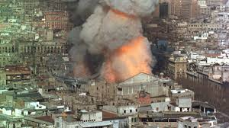
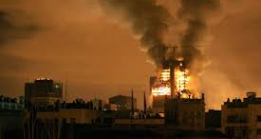

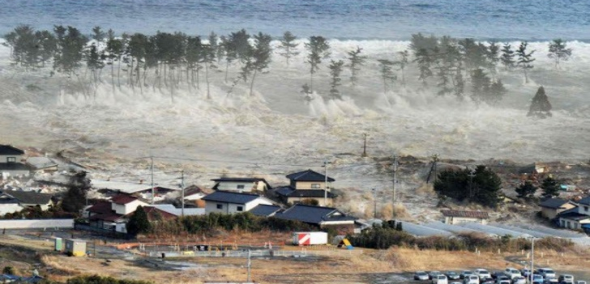
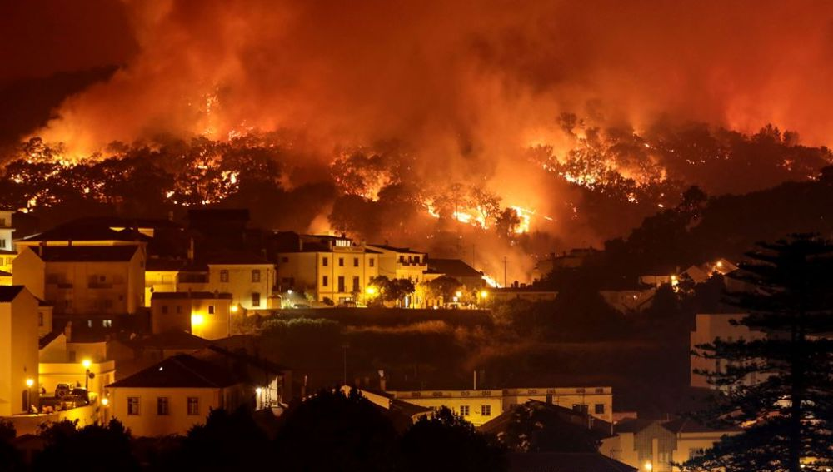
NATURAL DESASTRES
FIRES,
STUMANI, HEAT WAVES…
Portugal: at least 31 people died in their worst day
Notes:
Natural desastres are difficult to predict, though anticipated, they are easier to control and could make a big difference aliviating the terrible consecuences they bring.

Slide 3
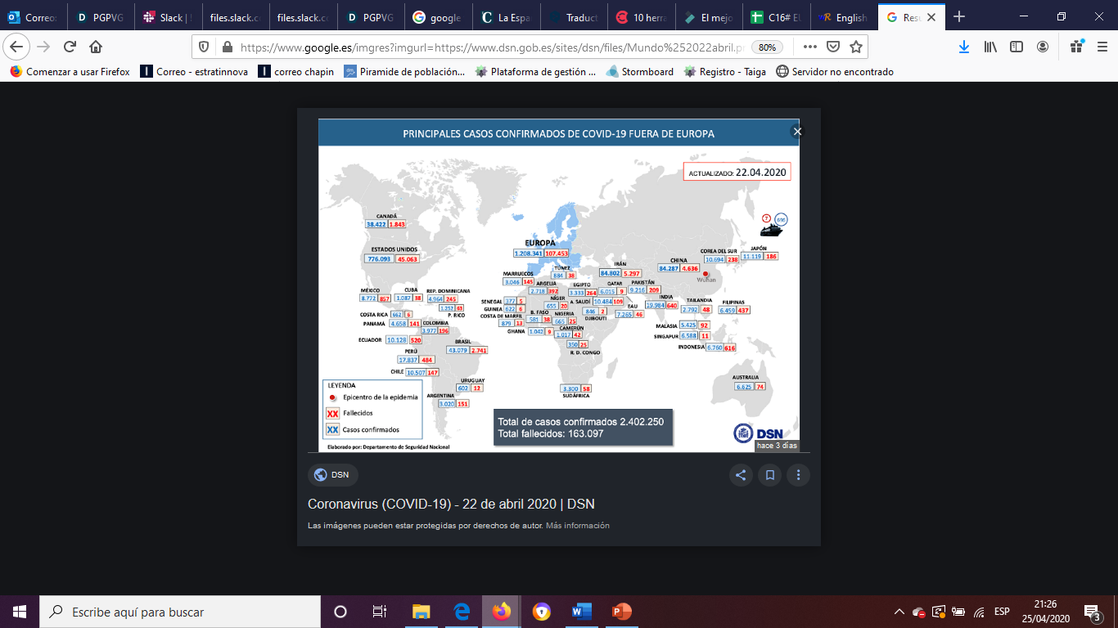
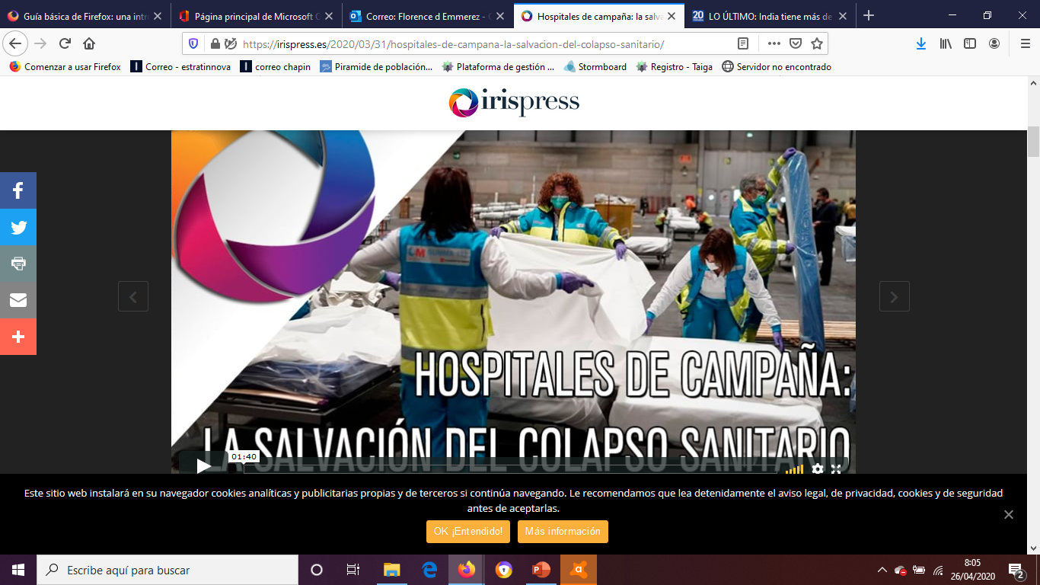
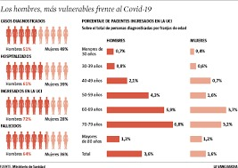
GLOBAL HEALTH CATASTROPHEE
WORLWIDE PANDEMIC
Notes:
Global health catastrophees such as the Covid-19 can create a worldwide pandemic with deastrous effects.

Slide 4
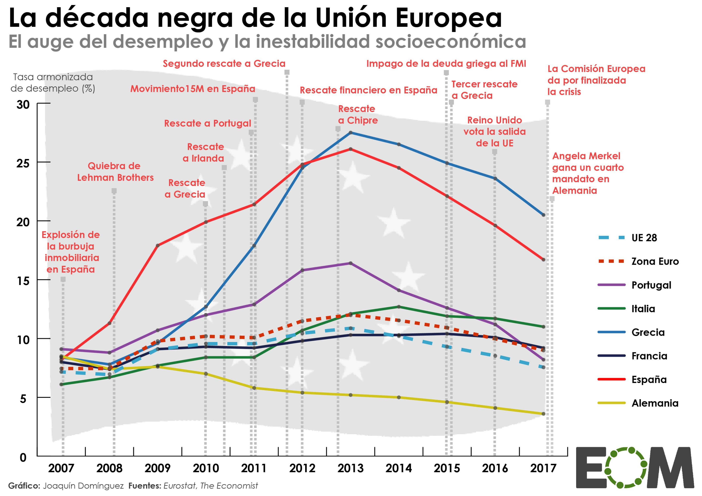
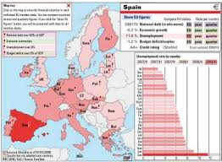

UNEMPLOYMENT, SOCIAL INSTABILITY & SEVERE ECONOMIC CRISIS
Notes:
The European Union will have to face high unemployment rates, social instability and a severe economic crisis

Slide 5
Problem
Countries' discoordination, lack of collaboration and consensus.
Reactions and solutions based on political situation of each country instead of based on medical common criteria. Lives of citizens and economic future of each country should not depend on political colours.
Lack of common European criteria, intervention protocols and rules/policies in the sanitary field.
High impact on lives, economies and personal individual situation of each citizens.
Increase of poverty gap, gender equality gap.
Lack of centralization of medical records across Europe and also in each individual country.
Fully demonstrated the vulnerability of the different health systems.
Notes:
To name a few, we are, unfortunately, dealing with many important problems such as a disccordination and lack of collaboration, consensus and commun intervention protocoles which lets the lives of our citizens in the hand of the political parties. This lack of centralization and of a unique medical record is having severe effects on the population by increasing the poverty and gender gap even more.

Slide 6
Solution and advantages
NOW has come the time to cooperate, share resources, experiences and learnings from everyone.
For Governments & Institutions
For the health care system
For the society and its citizens
Costs reduction
More proactiveness
Better crisis management
Better resource allocation
Mortality rate reduction
Personalised patients care
Hospitals less collapsed
Predictions of hospital saturations and future needs of resources
Improved attention of the patients and citizens with personalized treatments
Less deaths and grief for lost lives
Availability of resources and less poverty
Notes:
Our solution would bring many benefits for different parties such as more proactivemness and better resources allocation for governments, less mortality and saturations of health care sistems and less poverty and greif for the European citizens.

Slide 7




Population risk stratification and intervention protocols
Pyramid risk stratification
Prediction Model
Covid19
Age>60
nursing homes
Cardiovascular
HBP
COPD
Immunodeficiency
Diabetes
Actions
Covid19
Extreme
High
Medium
Low
Coordinate
Prioritize Protect
Communicate
Logistics
…
Governments
Healthcare
112
Police, Fireman
Army
Heterogenous Data Sources
Healthcare
Open Data
Socio demographic
Economy
Weather Agency
Social networks
…
Classification
Automatic Actions
Communications
Risk Management
Type:
Covid19
Fires
Floods
Economy
…
BPM
Protocols
Actions
Covid19
Services
Service1
Service 2
…
Notes:
From heterogenous data sources the plarform, thanks to diffrent algorithms, will determine according to the crisis type and the population risk profiles, the actions and protocoles to launch with each stakeholders and institutions.

Slide 8
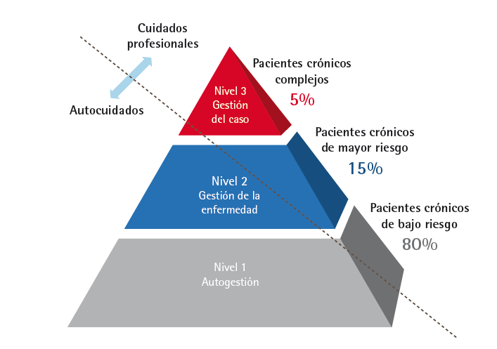
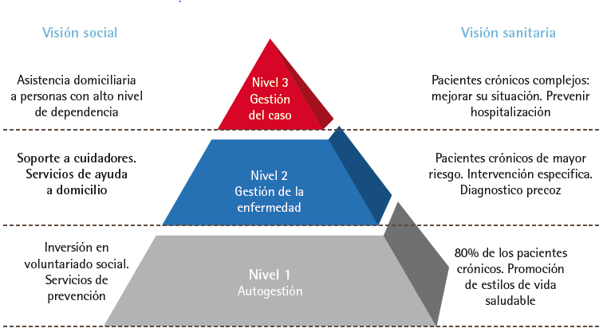
#EUvsVirus
PGPVG
Project
The Kaiser population model for the provision of services at the most cost-effective level of care to improve population health.
The King’s Fund recently examined in a recent report, people´ trends in spending on social services for elderly perssons
PLATAFORMA DE GESTIÓN DE POBLACIONES DE RIESGO
1st challenge:
Integrated solution as Support on Crisis Situation considering:
Care Strategy for Patients with Chronic Diseases in the Community of Madrid
PLATAFORMA DE GESTIÓN
DE POBLACIONES DE RIESGO
Put the platform at the service of institutions which work with risk patients:
First level of care, Socio-health care, Dependency care

Slide 9
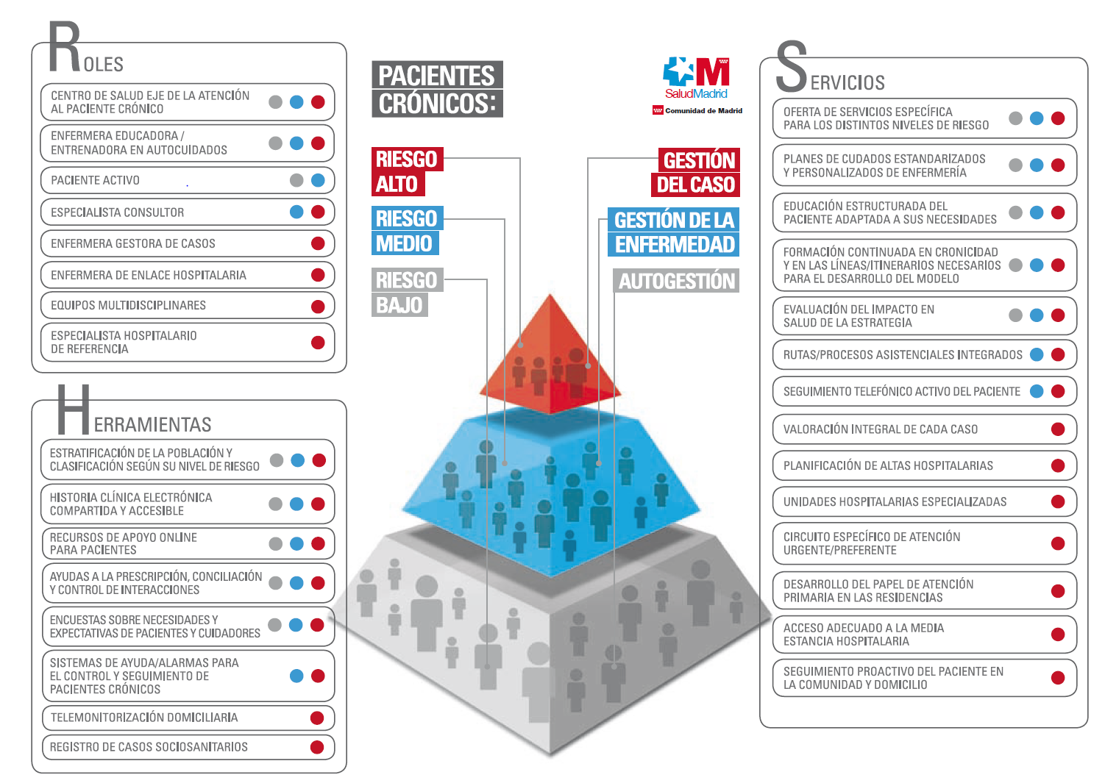

#EUvsVirus
PGPVG
Project
2st challenge:
Integrated solution as Support on Crisis Situation considering:
Madrid Community existing tolos and specific requirements to follow up the riks patients
The proposed platform must respond to the requirements that CAM tools need for monitoring risk patients

Slide 10



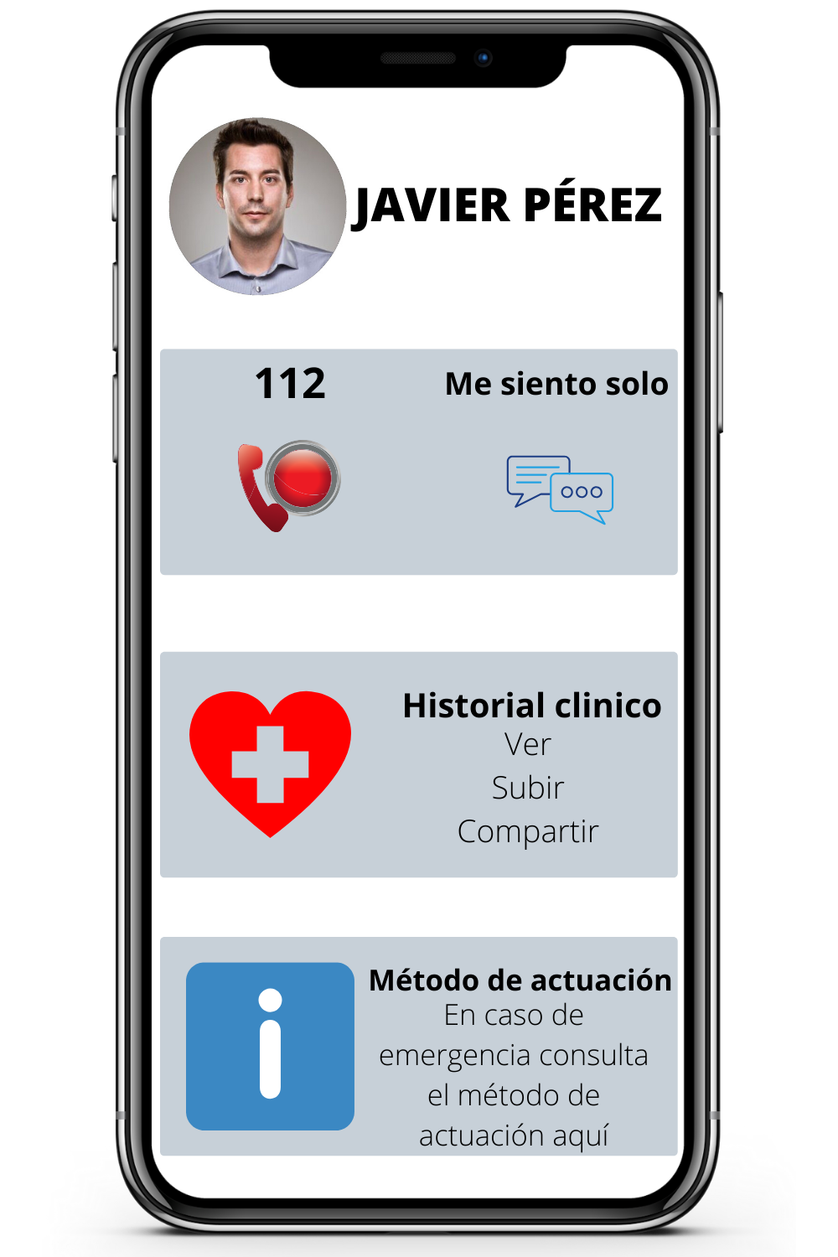





Risk Population Management Platform (PGPR)
Actors
GovernmentHealthcare Services
Heterogenous Data Sources
(Healthcare, Open Data,..)
RDB
NoSQL
RDF
CSV,..
Big Data Platform
Consumers
Service1
Service 2
…
Semantic Knowledge Layer
End user
Data Collection
Real Time
Import Data
SQL Query
Data Curation
Normalization
Cleaning
Storage
Analytics
Machine Learning
Analytics
Visualization
Dashboard
Graphs
D3 js
Data Storage Layer
Notes:
Our platform, using Big Data, Artificial Intelligence, Predictive Modellings, BPM, Geoanalytics, Graphs and Dashboards will accelerate and ease the interventions required, for a specific and personalized attention.

Slide 11
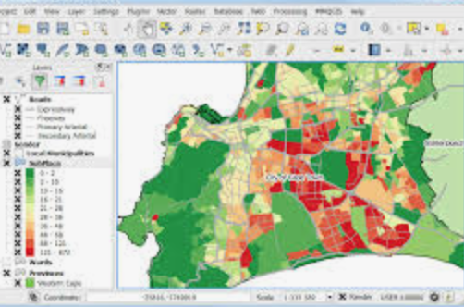
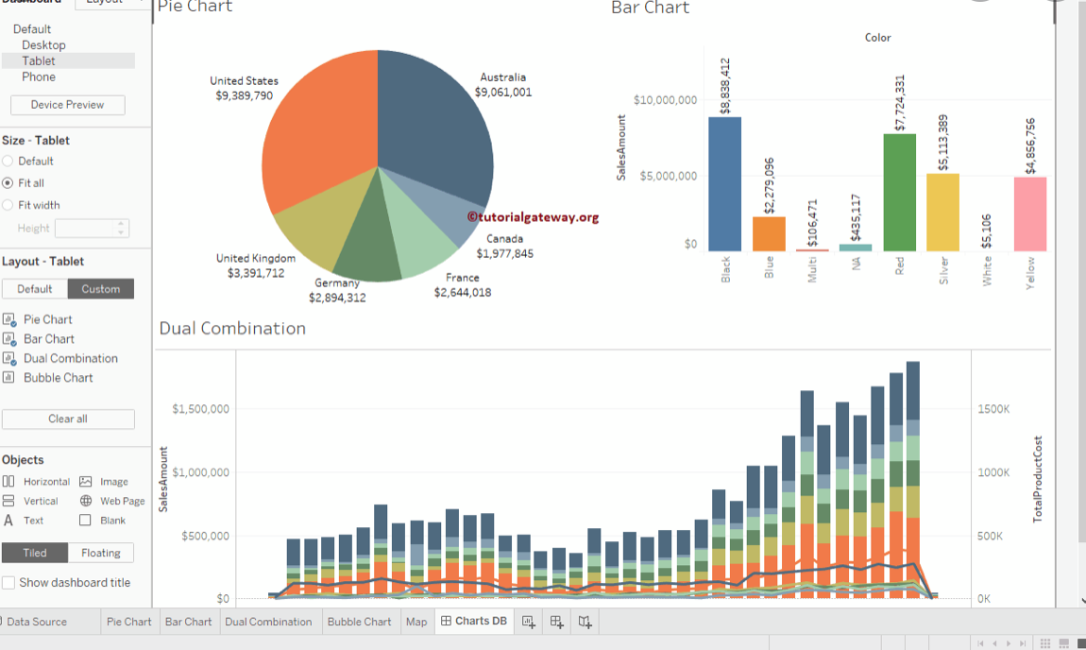
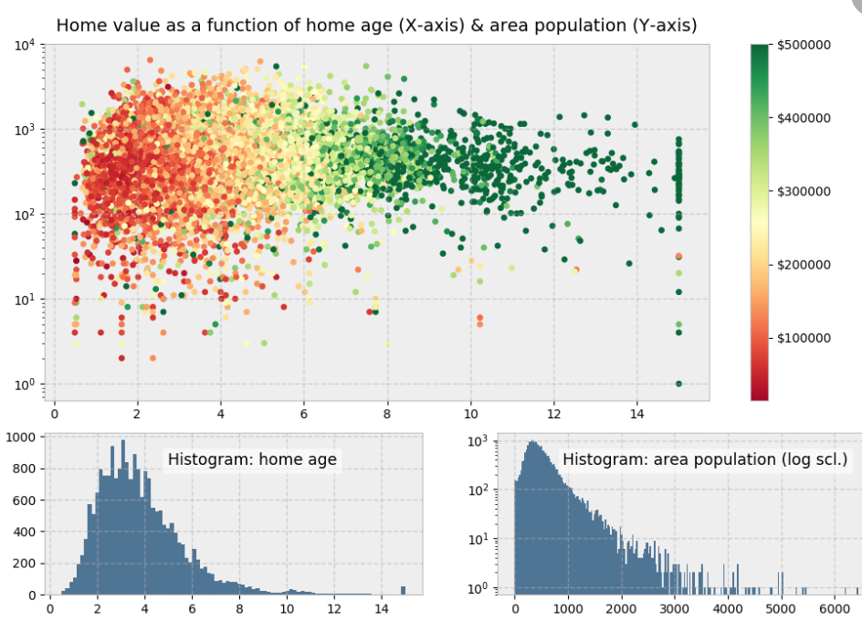
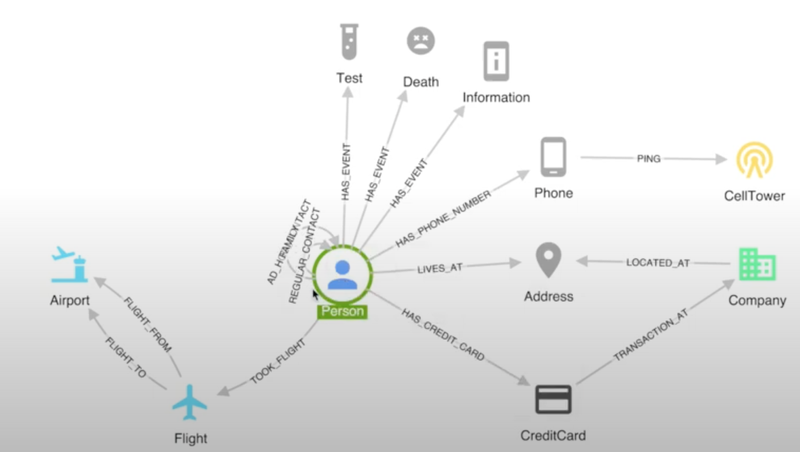
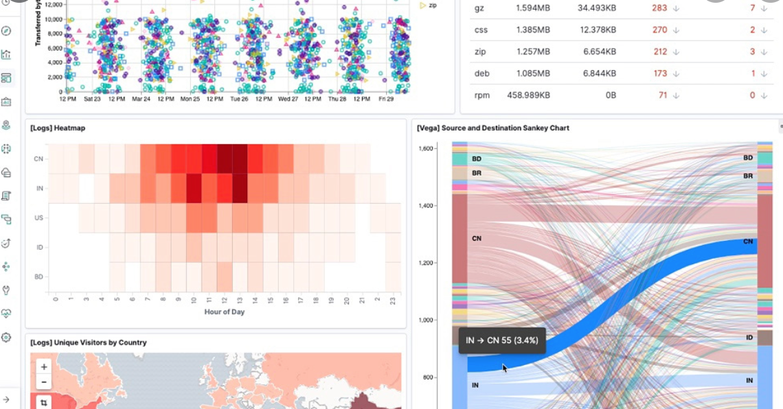
Data Visualization
Risk Population Management Platform (PGPR)
Geo Analytics (GIS)
Dashboard
Data Scientist
Graphs
Real Time Analysis
Notes:
By means of specific dashboards with real time analyisis, our tool will facilitate a data vizualization, sending warning alerts and producing specific intervention protocoles at a global and national level for the most vulnerable citizens.

Slide 12
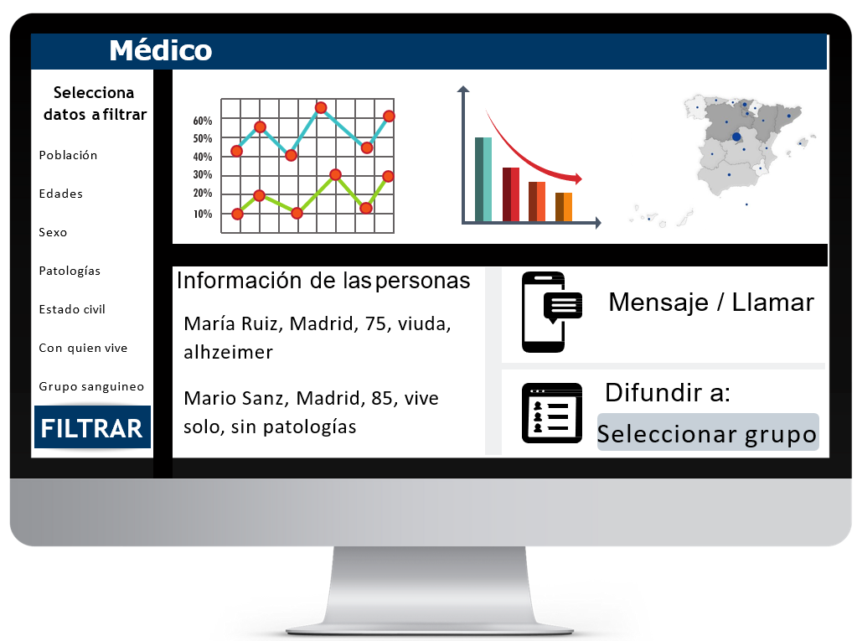

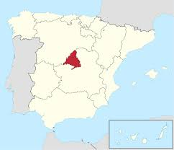
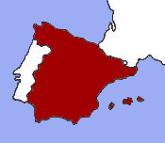
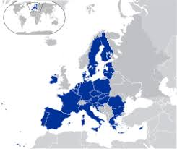
#EUvsVirus
PGPVG
Project
MVP
Control
Panel
Services => Society Resources
Big Data
Machine Learning / AI
IoS
(Final Users:
Risk Population)
Scaled/Synchronized Integration
From data processing on the platform on 1st wave in Covid19, prevent service coordination for the foreseen 2nd and 3rd wave after lockdown policy
KPI
#infected/Xi,Yi,Zi, Ki date
#dead/Xi,Yi,Zi,Ki date
#recovered/Xi,Yi, Zi ,Ki date
Xi=risk pop
Yi=protocol
Zi=level of service integration
Ki=resources employed per service
Theoretical pattern: Simulated education under different scenarios & hypothesis
Control panel: Disclosed info and monitored machine learning results to be applied on protocols: % reduction on pandemic effect evolution (deaths, infections, overloading services, resources, reaction time, PIB, unemployment…)
1s level
Regional Community
(MVP Validation in Madrid
for Covid19)
2nd level
State Comm.
(MVP Validation in Spain)
3rd level
European Comm.
(MVP Validation in EU)

Slide 13
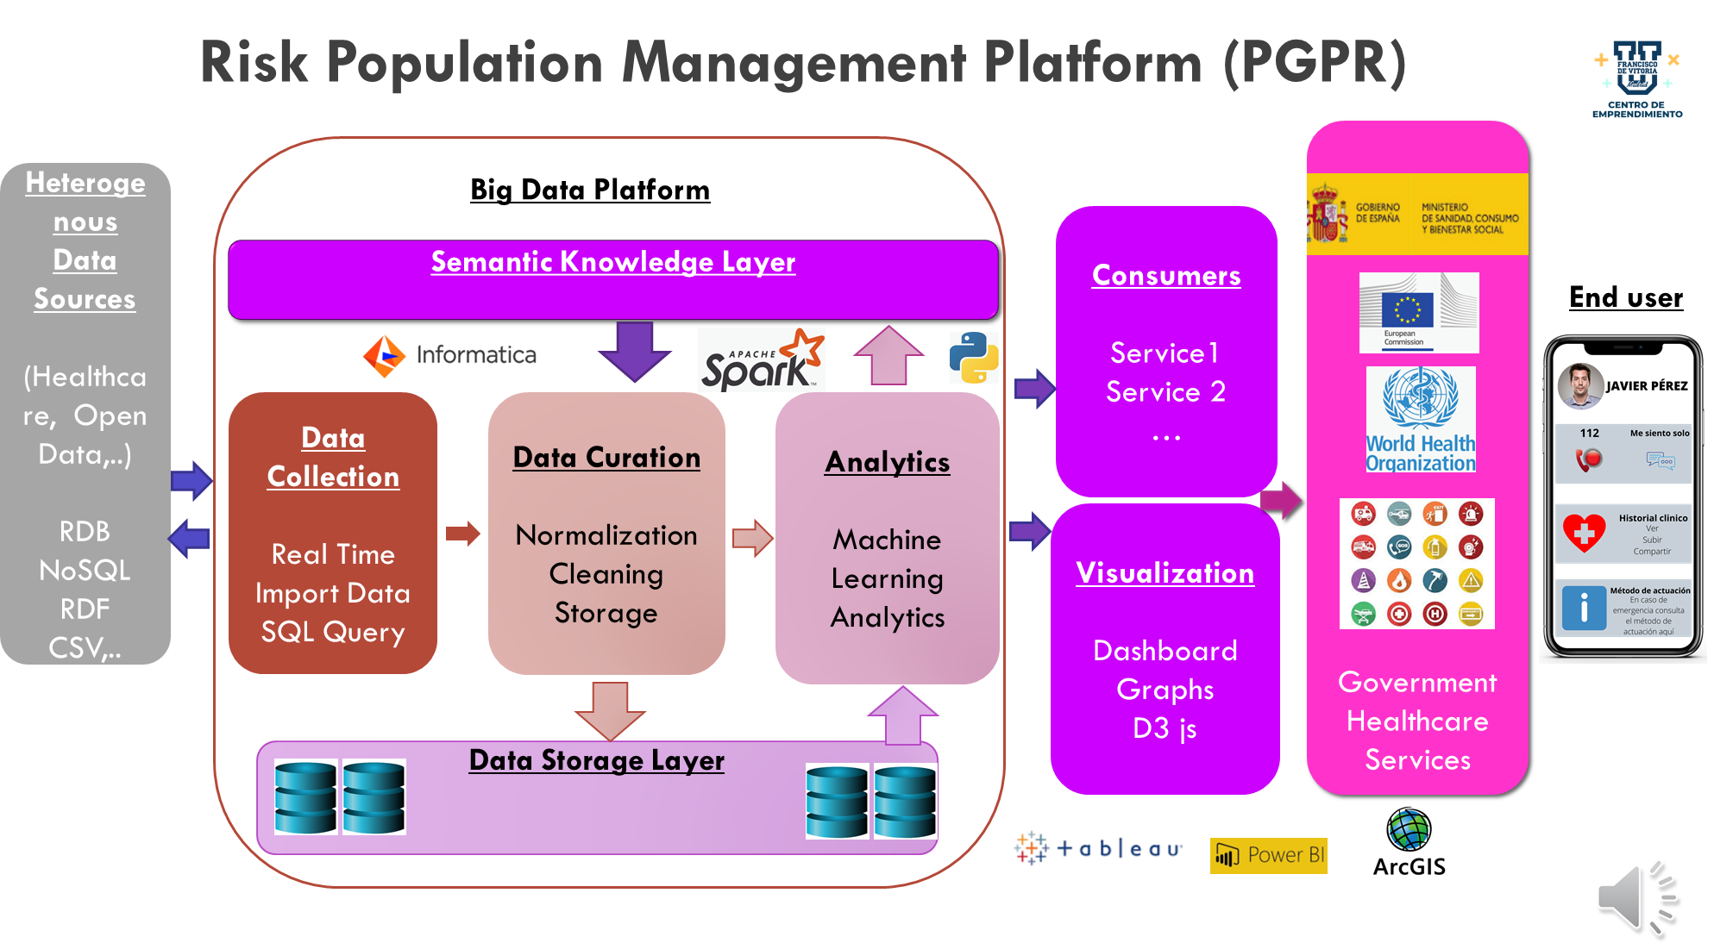

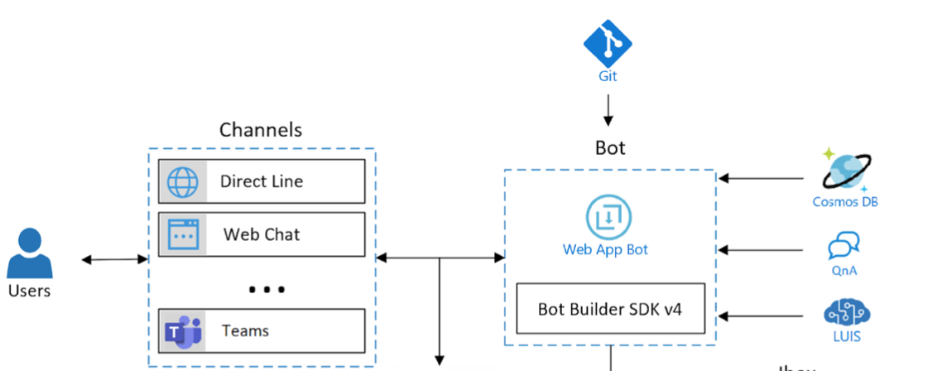

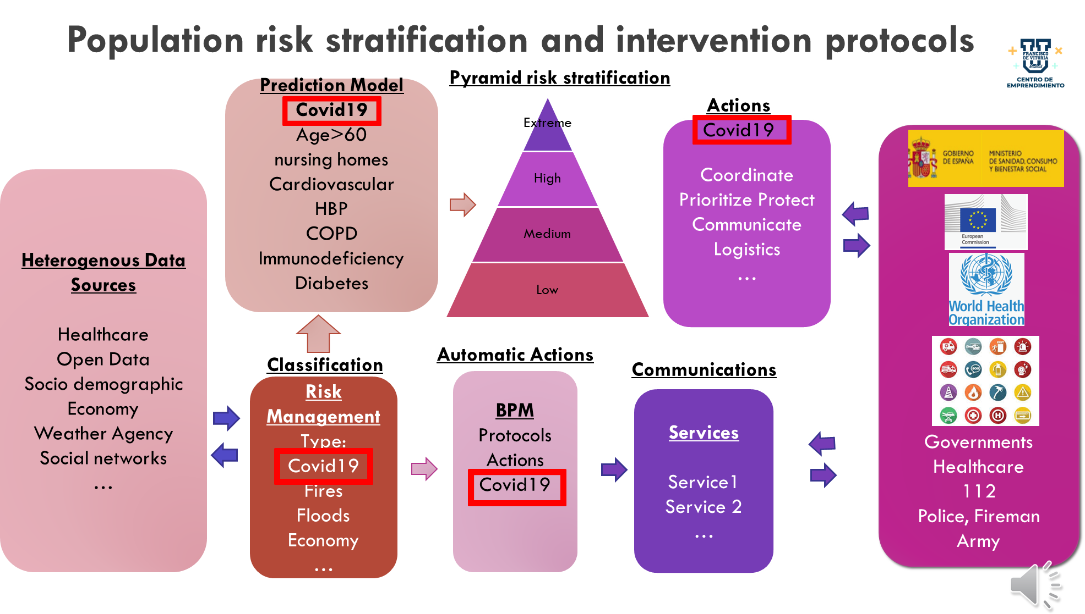
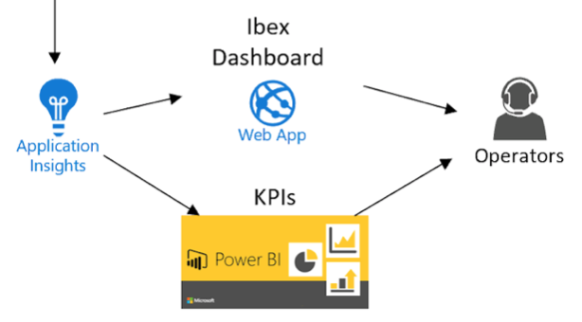


#EUvsVirus
PGPVG
Project
Product Description
Technology
Platform Architecture
Predictive Design
Base de Datos
Back end
Preguntas/Respuestas
Proccesing to Nat Languagel
Red interna
Emergencies112
Info EQUIPO

Slide 14

1. VALUE PROPOSITION:
Platform structured as a Big Data predictive system who learn data, detect crisis and coordinate services to healthcare risk population. Allows diminish effect of large pandemics or global crisis taken into account risk factors through to machine learning protocols and synchronization + integration of the existing social resources. This proposal is potentially scalable, flexible enough and design layered to be extended at total EU territory under a common European policy on situations like pandemic or natural disasters.
#EUvsVirus
PGPVG
Project
Business Model
Canvas
Strongly FEASIBLE:
2. Strategical alliances w/ BigData-SW suppliers & academical institutions.
Highly DESIRABLE:
5. B2B oriented to local public administrations to protect global risk population. Potential demand is tot population of a region, depending on the user segment to be processed and considered.
3. Permanent contact w/ local society resources.
4. Participation on periodical simulacrums & data updating
6. EU commission and regional authorities progs for SME/STUP
7. Promote trial testing and research outreach
Safety VIABLE:
8. MVP ready in 3 months (75.000Eu)
First layered integration in other 3 months
from validation date (150.000Eu)
9. IP and system maintenance, research and data process in and testing; first 18 months from a dedicated spin-off (25.000Eu): university-public/private institution

Slide 15

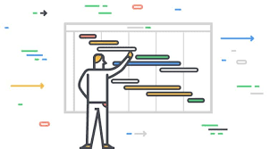



#EUvsVirus
PGPVG
Project
Start Up
Initial Investment:
FFF 3.000 Eu
University 3.000Eu
BA/Pub.Priv.Institutions 19K Eu
Request founds: 25K Eu
Society:
IT(AI&BD) + HealthTech
Spin-off (6-12 months,75K Eu)
Start Up (12-18 months / 2 investment rounds: 100K & 1MEu)
SpinOff
2nd round STUP
1st round STUP
Timing:
Validated
MVP
Sales: 500K-750K
EU Area
European Consortium
Sales: 225K-350K
State Area per Regions
Local/National Consortium
1st sale
75K
Regional Area
3
6
12
18
months

Slide 16

Help us to get ready for next waves and future catastrophes!
Notes:
Lets get prepared for next waves and future castastrophes!

